Slide 1
Homology modeling of antibodies for antibody engineering
Arun
Maya
Udhaya

Slide 2
Homology Modeling
Homology modeling is one of the computational structure prediction methods that are used to determine protein 3D structure from its amino acid sequence.
Homology modeling allows to build the structure of a protein when only its amino acid sequence and the complete atomic structure of at least one other reference protein is known.
The reference protein must be structurally homologous to the model protein being build.

Slide 3
Popular homology modeling tools and servers
Homology modeling tools | URL address | Short Description
Modeller | https://salilab.org/modeller/ | Is a homology modeling tool that generates protein 3D structures with spatial restraints method. It is available freely, has powerful features, and gives reliable results.
Swiss-Model | https://swissmodel.expasy.org | Is a server that gives protein 3D structure from its amino acid sequence. It provides user-friendly Web interface. This server uses model quality estimation to select the most appropriate templates and gives the expected accuracy of the models built Approximately.
Rosetta | http://www.rosetta.org/ | Based on the ROSETTA fragment insertion method, it gives both ab initio and homolog models of protein regions.
intfold | http://www.reading.ac.uk/bioinf/IntFOLD/ | It is an independent server that predicts intrinsic disorders, domains, and protein–ligand binding sites.
Structural Antibody Database (SAbDab) | http://opig.stats.ox.ac.uk/webapps/sabdabsabpred/ | SAbDab is a database containing all the antibody structures available in the PDB, annotated and presented in a consistent fashion. Each structure is annotated with a number of properties including experimental details, antibody nomenclature.
Kotai | https://sysimm.org/tools. | High-throughput structural modeling for B-cell and T-cell receptors.
prime | https://www.schrodinger.com/prime | Is a powerful package for accurate protein structure prediction. In addition to building structures with high accuracy, it provides advanced simulation. It makes homology modeling and fold recognition merge into a package. It has an easy-to-use interface.

Slide 4
What is antibody?
It is Y shaped group of glycoprotein also called immunoglobulin(blood protein) produces response to the antigen (foreign invaders such as bacteria, virus, toxin(snake toxin, abused drug/meth), bug toxin(e.g. deadly tick bite) to destroy, inactivate or neutralize them.
Hence its body’s self defense protein to prevent or fight with diseases.
Two types:
Polyclonal
Mixed population
Monoclonal
Single antibody
Only bind to single specific site
May bind to different areas of the target sequence.
Cheap to produce
Small mutation can be unnoticeable
Able to recognize particular protein form (even small mutation)
Expensive to produce
Monoclonal antibody being highly sensitive to antigen than polyclonal, clones of specific parent cell can be targeted and hence can be used as drug for specific disease or target disease such as lungs cancer, antivenom for specific snake toxin.

Slide 5
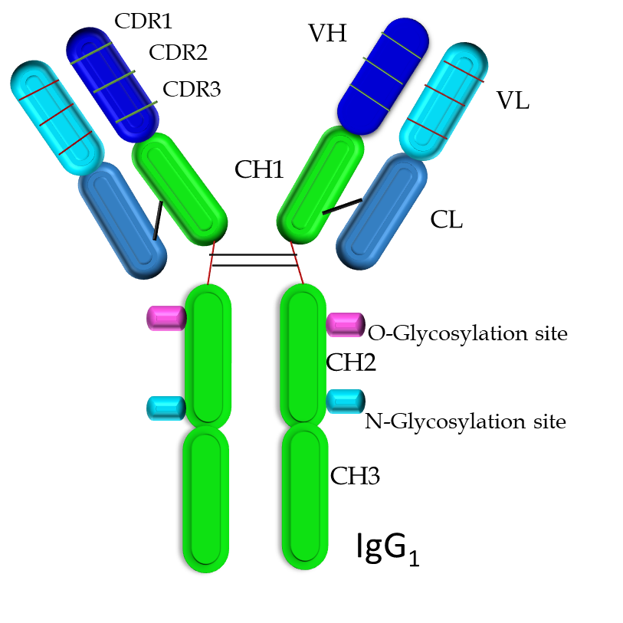
Background of antibody
Antibody is Y shape molecule along with heavy chain and light chain. The antibody is 150 kDa molecular weight.
The antibody has foreign substances binding sites is called complementary determine regions (CDRs).
There three CDR regions of heavy chain [H-CDR1, H-CDR2 and H-CDR3] and the three CDR regions of light chain [L- CDR1, L-CDR2, L-CDR3]. Intervening region in CDRs are frame of residue(FR).
The contact CDR definition of antibody sequence to position the CDRs of the murine antibody light chain and heavy chains at the following locations: H-CDR1 ₂₆₋₃₅, H-CDR2 ₄₇₋₆₅, H-CDR3 ₉₃₋₁₀₁, L-CDR1₂₄₋₃₆, L-CDR2 ₄₆₋₅₅, and L-CDR3 ₈₉₋₉₆.

Slide 6
Steps Of Homology Modeling
Why homology modeling for antibody?
“Helps to know loss and gain function of antibody protein through homology modeling which will be utilized improve or drop functionality to produce optimized antibody.”
Identification of target gene
Sequence alignments
Models building
Visualize of models using PyMol software to see binding sites
Validation of models

Slide 7
Source of antibody gene
Mouse antibody sequence
>variable heavy chain VH
DVQLQQSGPGLVAPSQSLSITCTVSGFSLTNYGIHWVRQPPGKGLEWLGVIWAGGYTKYNSALMSRLSMSKDNSKSQVFLKMNSLQTDDTAMYYCARDEVRRDYYAMDHWGQGTTVTVSA
>Variable light chain (VL)
DIQMTQSPAILSASPGEKVTMTCWASSGVSYMHWYQQKPGSSPKPWIFATSNLASGVPARFSGSGSGTSYSLTISRVEAEDAATYYCQQWSFNPLTFGAGTKLEIKR

Slide 8
Antibody humanization: General strategy
Sources of antibodies: Mouse, rabbit, Rat,
Target antibody amino acid sequences
Bioinformatics analysis (Human germlines base consensus sequence design)
In silico homology modeling of target gene and humanization gene by combining consensus
Wet laboratory validation of antibodies properties

Slide 9
Homology Modeling with SWISS-MODEL
SWISS-MODEL is a fully automated protein structure homology modeling server
Accessible via the ExPASy Molecular Biology web server (http://www.expasy.org/)
Also accessible from DeepView (Swiss Pdb-Viewer) program
DeepView provides manual control during homology modeling and tools for analyzing generated models
MolProbity is a structure validation web server
Kotai web server to build 3D structure model

Slide 10
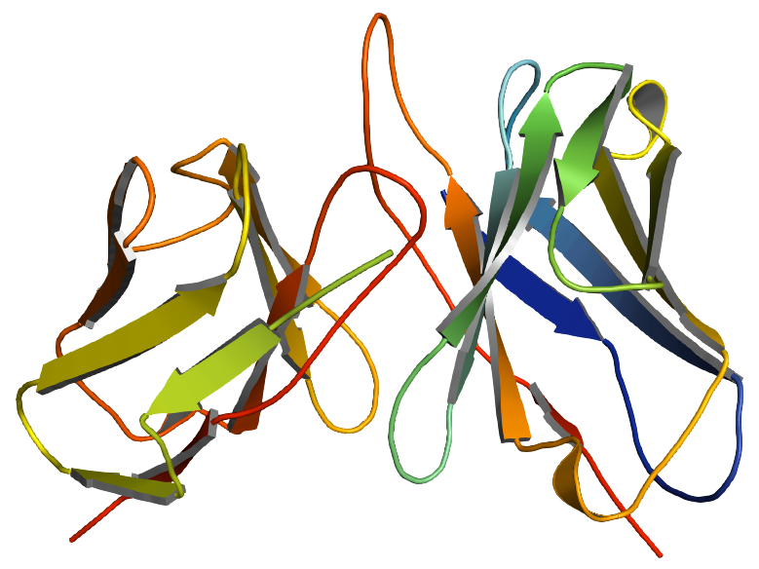
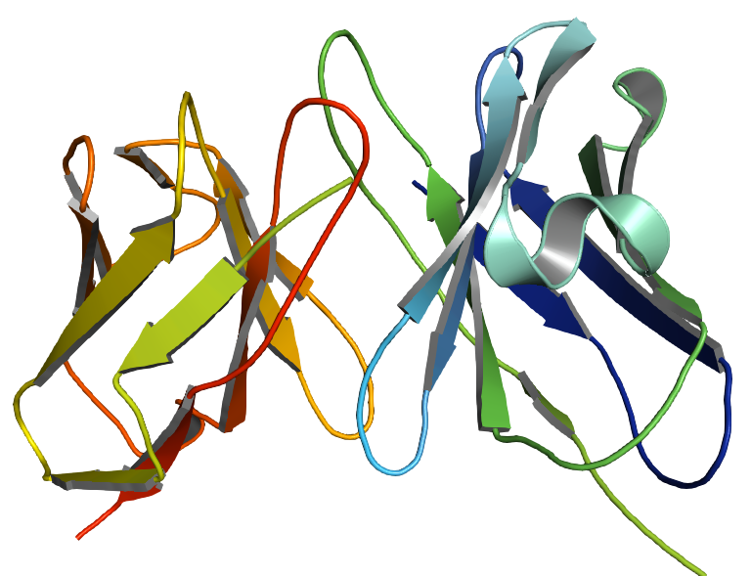
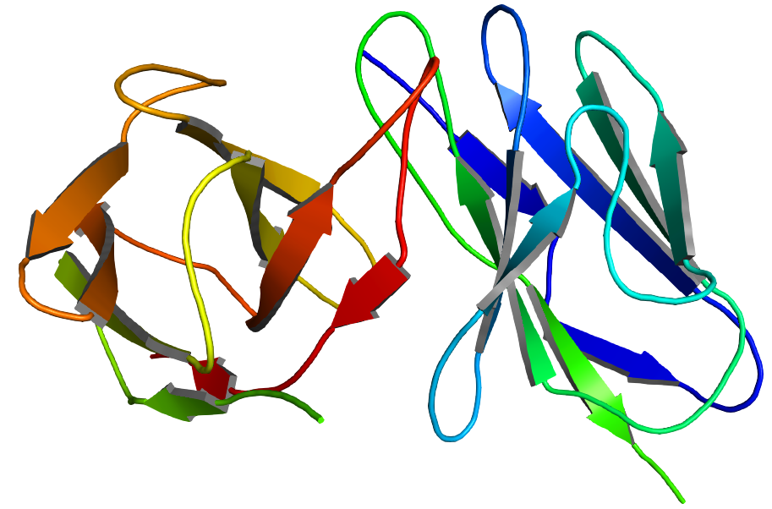
Antibody homology models
B
C
A
Fig. 1. Antibody generated using these software A. Swiss model: https://swissmodel.expasy.org B. Structural Antibody Database (SAbDab) http://opig.stats.ox.ac.uk/webapps/sabdabsabpred/
C. Kotai - https://sysimm.org/tools.

Slide 11
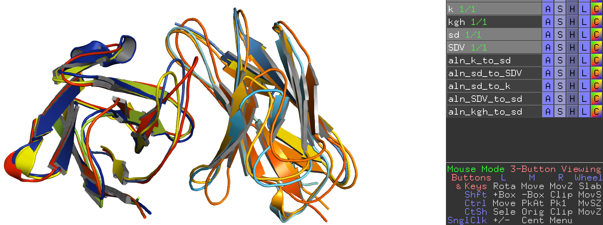
Overlapping models of different models using pyMol

Slide 12
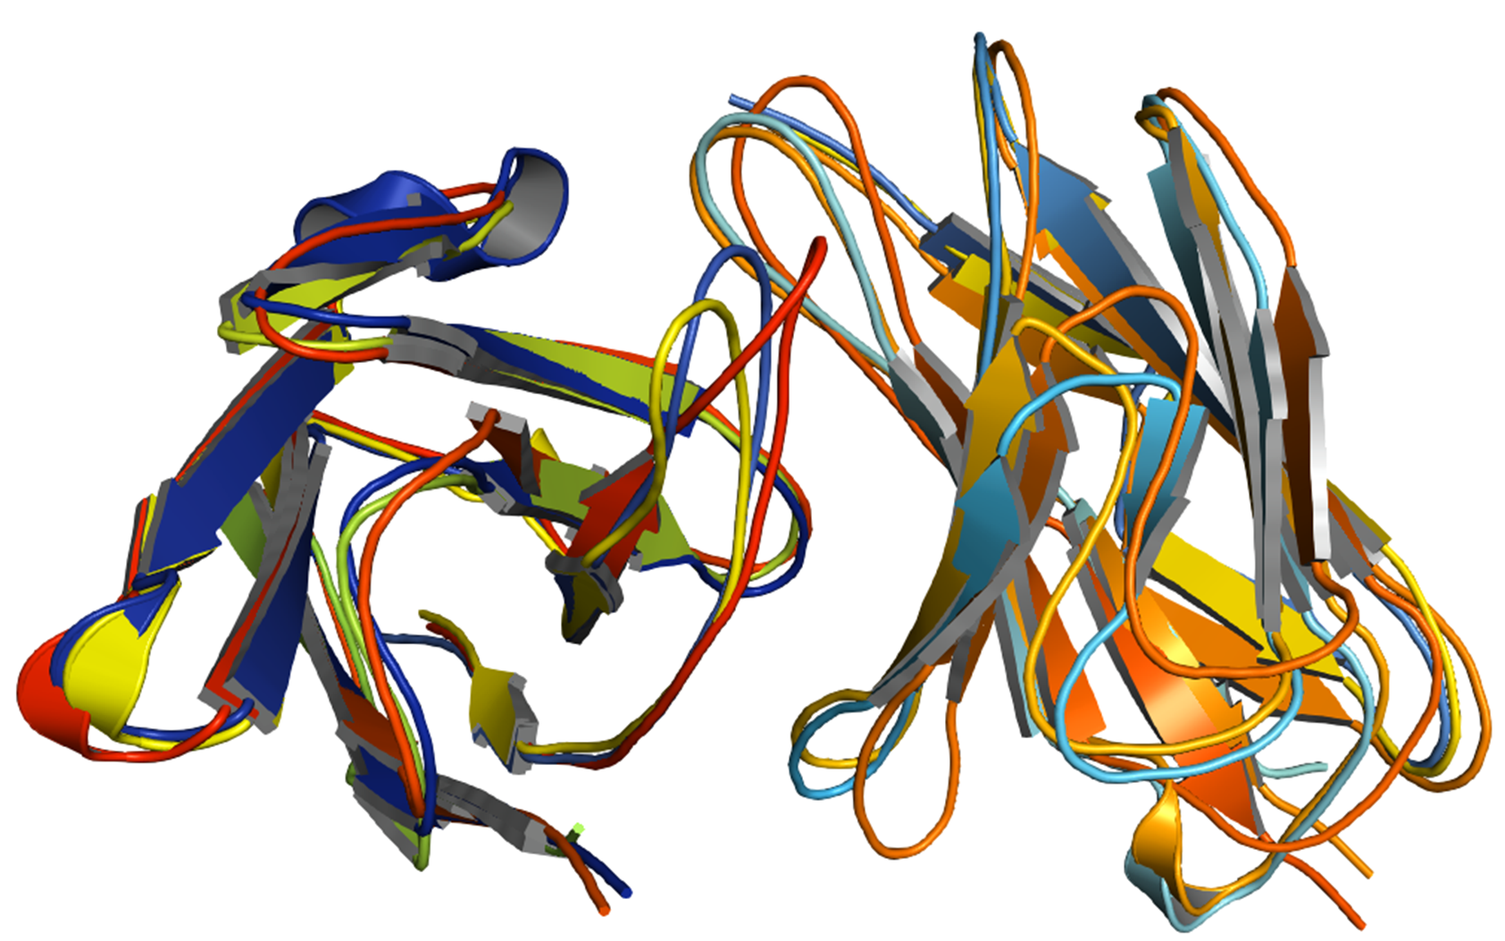
Overlapping of antibodies models
H3 loop of heavy chain
L3 loop of light chain
Variable heavy chain
Variable Light chain

Slide 13
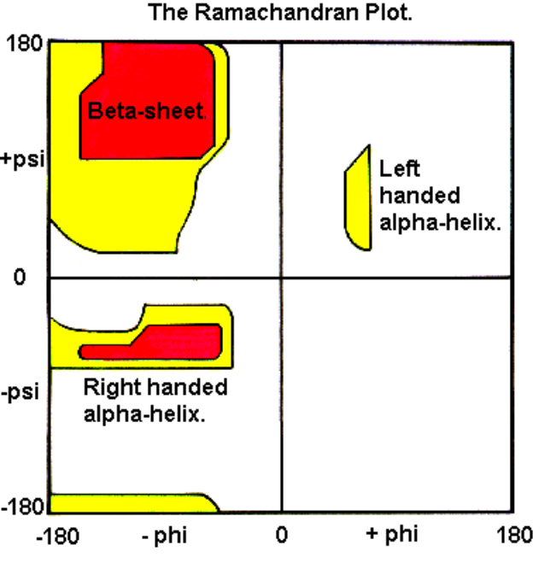
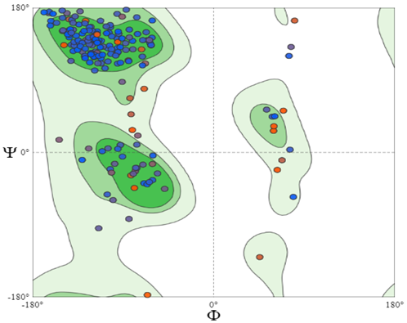
Ramachandran plot of antibody sequences
Tool used for computational validation of models
blue dots are residue and red dots are selected one. Green lines refer high resolution set proteins, black dots refer atoms in Alanine.
Amino acid residue is shown as a dot in a graph of φ vs. ψ, is commonly called as a Ramachandran plot or Ramachandran map.
Notes:
In the diagram above the white areas correspond to conformations where atoms in the polypeptide come closer than the sum of their van der Waals radi. These regions are sterically disallowed for all amino acids except glycine which is unique in that it lacks a side chain. The red regions correspond to conformations where there are no steric clashes, ie these are the allowed regions namely the alpha-helical and beta-sheet conformations. The yellow areas show the allowed regions if slightly shorter van der Waals radi are used in the calculation, ie the atoms are allowed to come a little closer together. This brings out an additional region which corresponds to the left-handed alpha-helix.

Slide 14
MolProbity is a structure-validation web service that provides evaluation of model quality at both the global and local levels for both proteins and nucleic acids.
Score | Comment | Ideal Case
MolProbity Score | Combined protein quality score that reflects the crystallographic resolution at which such a quality would be expected | As low as possible
Clash Score | Clashes show > 0.45Å non-H-bond | Zero
Ramachandran Favoured |  | > 98%
Ramachandran Outliers | At resolutions below 3.0Å, any outliers should be considered errors. | < 0.2%
Rotamer Outliers | At resolutions below 3.0Å, any outliers should be considered errors. | < 1%
C-Beta Deviations | Position deviates from ideal by > 0.25Å | Zero
Bad Bonds | > 4σ deviations from ideal | Zero
Bad Angles | > 4σ deviations from ideal | Zero
Cis/Twisted Prolines/Non-Prolines | < 30° from ideal defined as CIS; >150° from ideal defined as Twisted | Zero

Slide 15
Ramchandra plot Mol Probity Results
Mol Probity Score |  | 2.25
Clash Score |  | 4.38 | (A60 ARG-A78 GLU)
Ramachandran Favored |  | 90.99%
Ramachandran Outliers |  | 1.8% | A31 TYR, B4 LEU, B39 GLN, B40 PRO
Rotamer Outliers |  | 4.74% | A91 SER, B2 VAL, A46 TRP, A89 GLN, B90 THR, B24 VAL, A29 VAL, A18 LYS, A90 TRP
C-Beta Deviations |  | 8 | A31 TYR, B90 THR, B39 GLN, A95 LEU, B96 ALA, B32 TYR, A93 ASN, B92 MET
Bad Bonds |  | 0 / 1792
Bad Angles |  | 12 / 2437 | B103 ASP, B108 ASP, B90 THR, A4 MET, B96 ALA, A33 HIS, A90 TRP, (B103 ASP-B104 TYR), (B40 PRO-B41 PRO), B109 HIS, B35 HIS
Referring MolProbity value noticeable drop in affinity towards antigen is found which was expected result , now further wet lab experiments and validation should be done to optimize this result.

Slide 16
Some Energy minimization tools/servers
YASARA
pyMol script command
ModRefiner
GROMACS
Amber
Chimera
………………etc.
Recommendation: remove clashes, bad angles, optimize temperature etc. before starting energy minimization to lessen errors in result.
Tricky and hit and trial part: minimize energy optimizing condition and proceed to wet lab to get validation of structure, repeat until getting optimum result.

Slide 17
Conclusion
Supports better understanding protein world: Computational based homologues modelling methods as a valuable complement to experimental structural biology efforts towards increasing our understanding of the protein universe and of its properties.
Helps to Minimize cost: Mostly, antibody engineering is labor intensive, also it is design and cycle method, in most cases it results in a significant drop in affinity toward the antigen.
Helps save time for lengthy tedious wet lab experiment: This is due to sequence and structural knowledgebase design models to optimization of molecules that added values in protein engineering research area.

Slide 18
References:
Yoonjoo Choi, Casey Hua, Charles L Sentman, Margaret E Ackerman & Chris Bailey-Kellogg (2015) Antibody humanization by structure-based computational protein design, mAbs, 7:6, 1045-1057, DOI: 10.1080/19420862.2015.1076600
Andrew Waterhouse et.al; SWISS-MODEL: homology modelling of protein structures and complexes, Nucleic Acids Research, 2018, Vol. 46
Vinodh B Kurella & Reddy Gali, Structure guided homology model-based design and engineering of mouse antibodies for humanization, Bioinformation 10(4): 180-186 (2014)
Paolo Marcatili et, al; Nat. Protoc. 9, 2771–2783 (2014); doi:10.1038/nprot.2014.189;
Structure validation by Cα geometry: φ,ψ and Cβ deviation. Lovell SC, Davis IW, Arendall WB 3rd, de Bakker PI, Word JM, Prisant MG, Richardson JS, Richardson DC. Proteins. 2003 Feb 15;50(3):437-50
Rosalba Lepore et, al; PIGSPro: prediction of immunoGlobulin structures v2, Nucleic Acids Research, 2017, Vol. 45, Web Server issue

